Slide 1
GLOBAL OCEAN CIRCULATION AND CORAL REEFS in Encyclopedia of Modern Coral Reefs pp. 497–503 John E. N. Veron
Slides: S. Ikari
2022/06/07

Slide 2
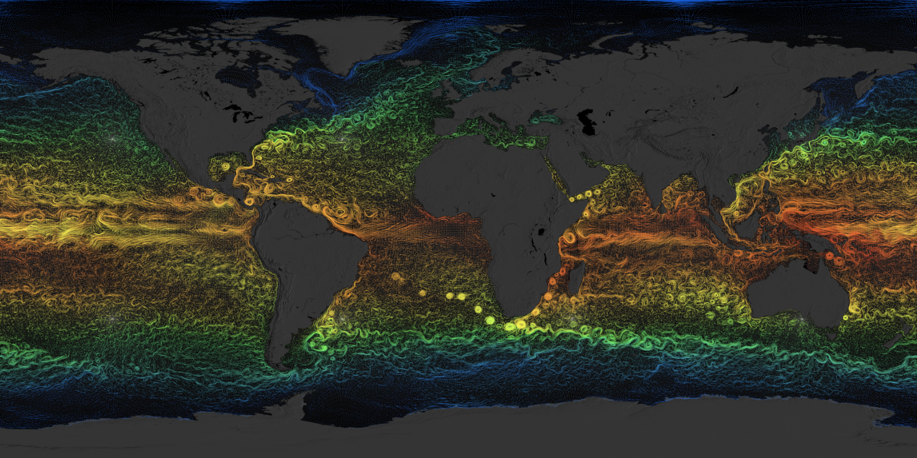
Ocean circulation denotes ocean-scale current systems that change seasonally but persist from one year to the next.
Estimating the Circulation and Climate of the Ocean, Phase II (ECCO2)
https://svs.gsfc.nasa.gov/3912

Slide 3
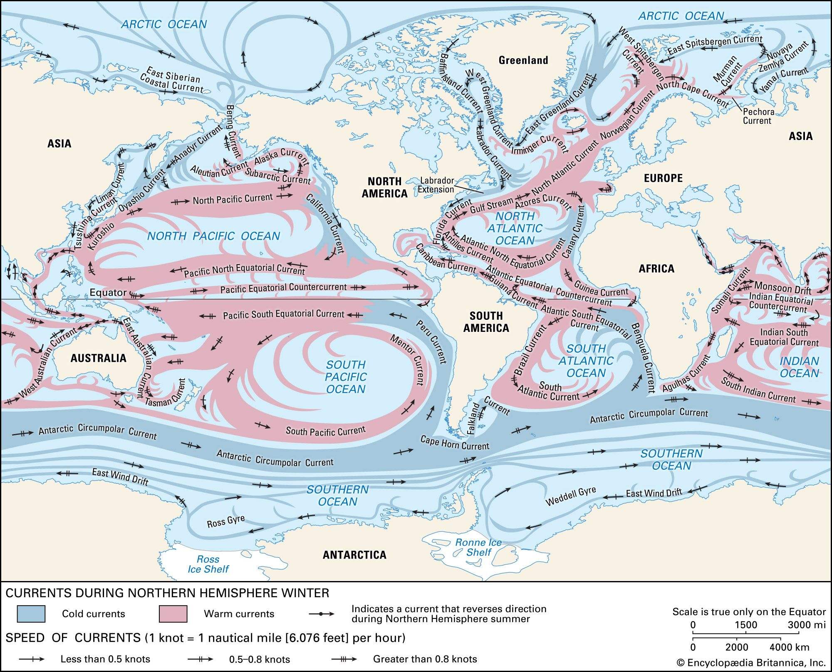
https://www.britannica.com/science/ocean-current#/media/1/424354/46367

Slide 4
Oceanic currents and coral reefs
Setting geographic extent of reef formation
Governing dispersal of larvae
Affecting evolution
Three dimensional nature of most types of shallow reef habitats
Fine-scale distribution of food, nutrients, oxygen, tides, waves
(out of scope of the article)

Slide 5
Temporal/geographical Scales
Ocean circulations regulates faunal distribution
jointly with other drivers
simultaneously in different scales
(temperature, sea levels, configuration of continents, etc.)
Global scale
Temporal scale of geological period (~10My)
Setting template for coral reef distributions and zooxanthellate coral distribution
Regional scale
Temporal scale of millennia (~1000)
Controlling of details of the distributions
Ecologically driven influence on reef development

Slide 6
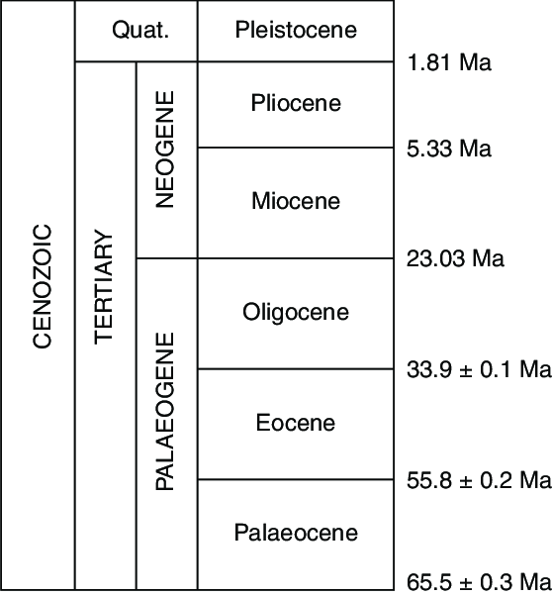
History of the Oceanic circulation

Slide 7
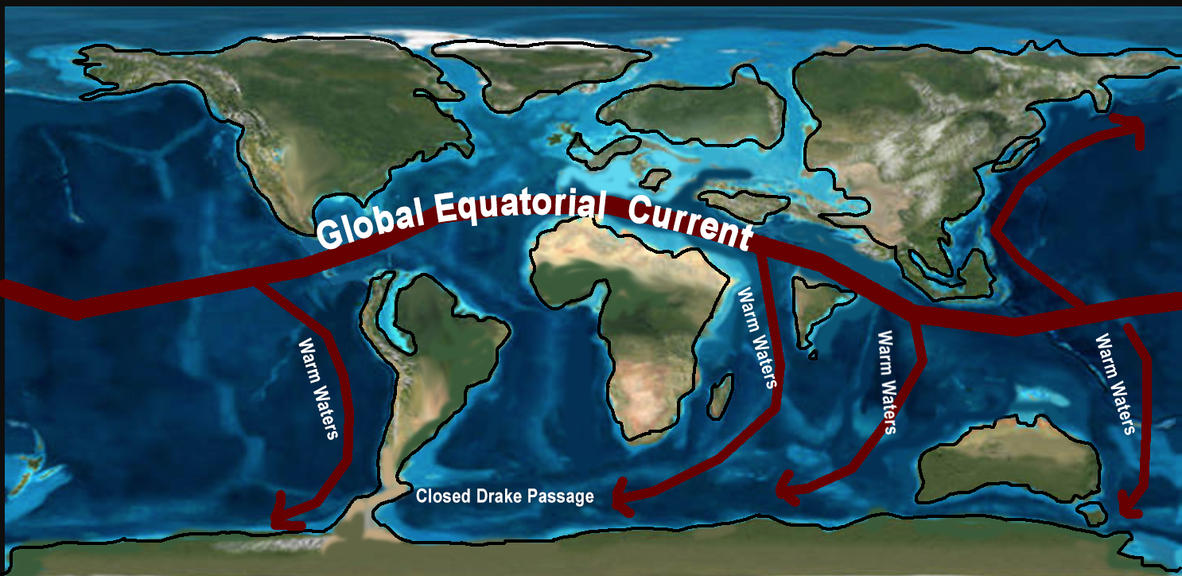
Early Cenozoic (~ 40-35Ma; Late Eocene to Early Oligocene)
Tehtys Ocean
Central American Seaway
Sluggish and warm
CC BY-SA 4.0. by Benjamin J. Burger.
https://commons.wikimedia.org/wiki/File:Eocene-Ocean-Surface-Circulation-Kept-Earth-Warm-During-Early-Cenozoic-Time.jpg
Tethys Ocean: largest cradle of marine organism

Slide 8
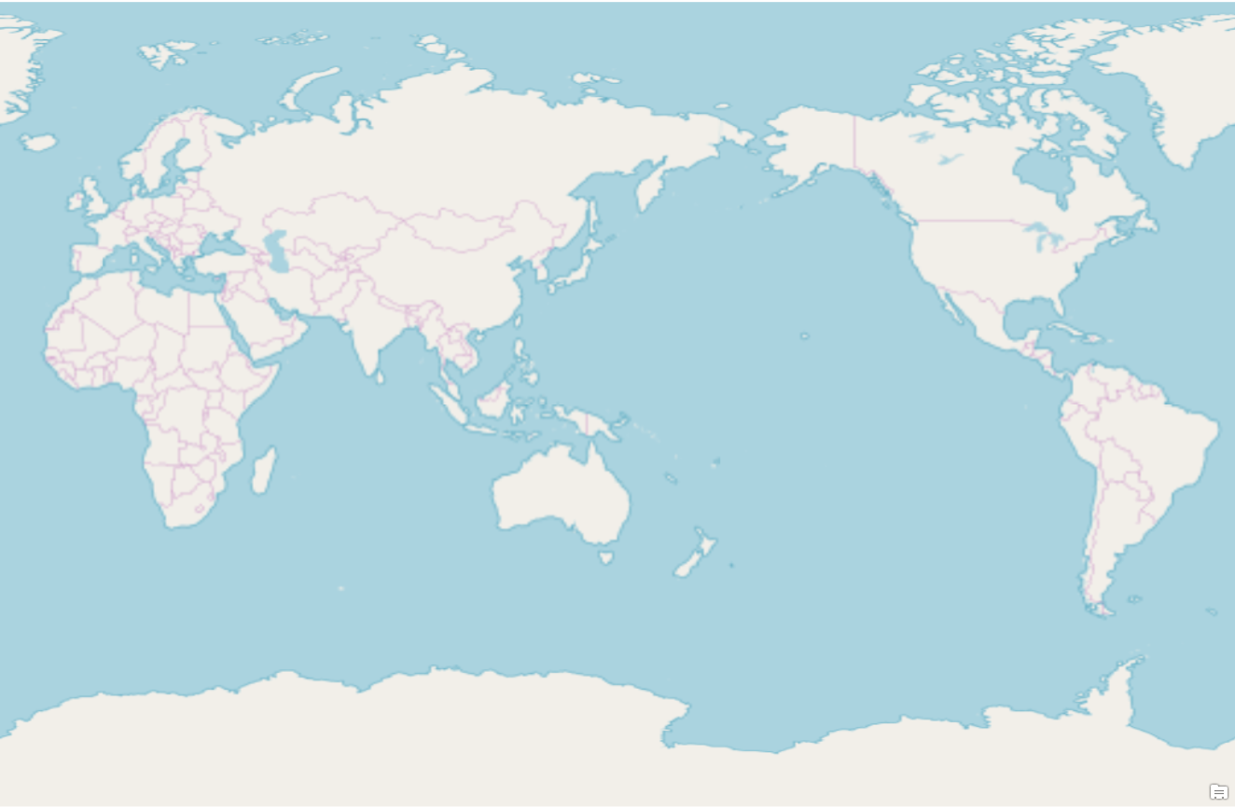
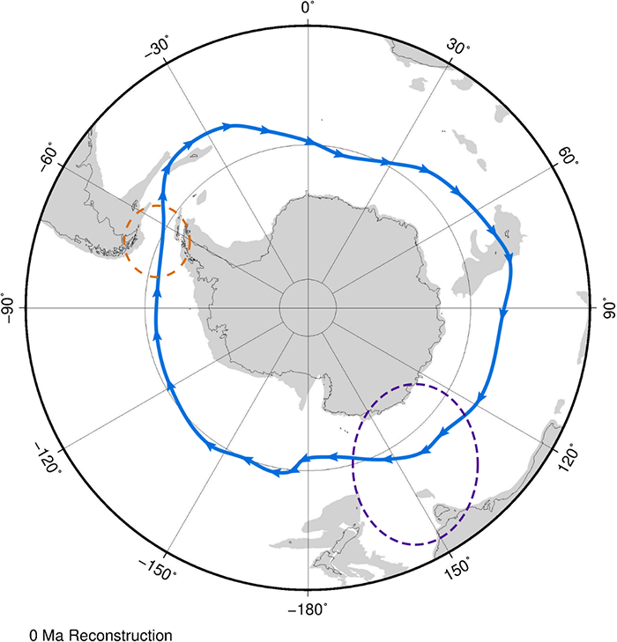
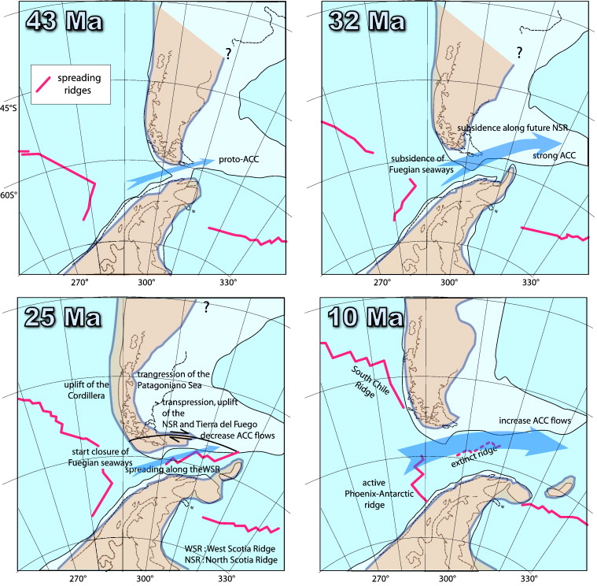
The formation of the Antarctic Circumpolar Current, mid Cenozoic
The Antarctic Circumpolar Current
Alexander, 2018
https://www.open.edu/openlearn/nature-environment/environmental-studies/when-did-the-largest-ocean-current-on-earth-start
Lagabrielle et al., 2009, Earth and Planetary Science Letters.

Slide 9
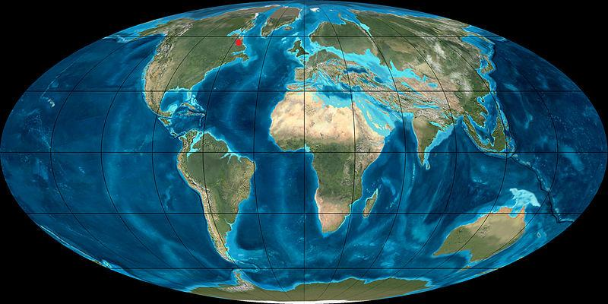
The formation of the Antarctic Circumpolar Current, mid Cenozoic
Cold water is deflected north along the western margin of each continent.

Slide 10
The formation of the Antarctic Circumpolar Current, mid Cenozoic
10-15℃
decrease
Results in latitudinal temperature gradient (not existed in early Cenozoic)

Slide 11
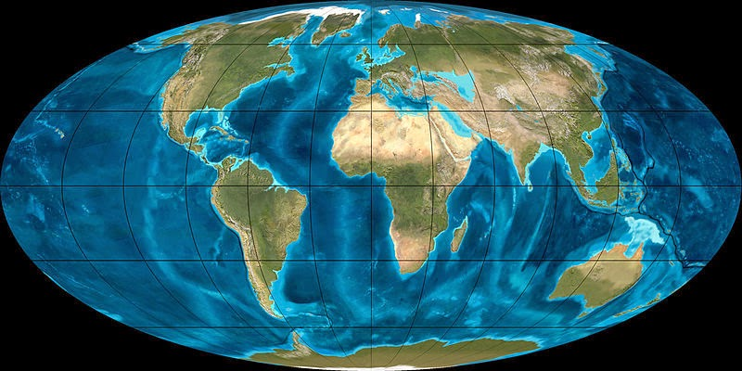
Late Cenozoic
①
②
choked off during
the Late Miocene (10 mya)
Widening of the North Atlantic
→Regulation global climates via the Ocean Conveyor and Gulf Stream
② Shrink of the Tethys Sea
→Closed connection between the North Atlantic and the Indian Ocean

Slide 12
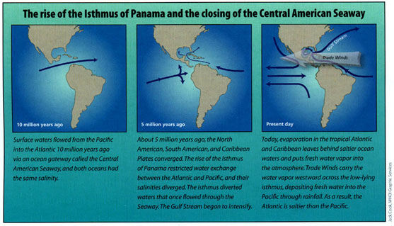
The formation of the Isthmus of Panama; completed in 3.4Ma
Haug et al. (2004). Oceanus.

Slide 13
Oceanic circulation and biodiversity distribution

Slide 14
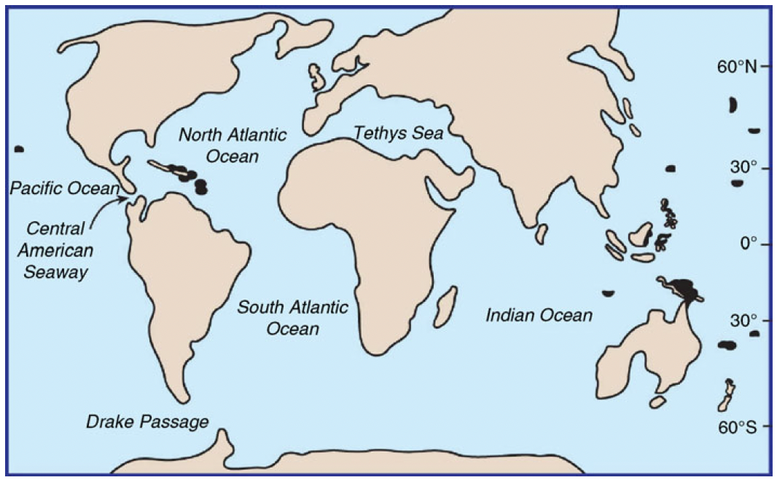
Biodiversity transfer
Biodiversity transfer from Thytes to Caribbean/Indian Ocean
Miocene ended with extinction of old-Thytes fauna
Late Miocene reef remains are very common in the western tropical Pacific/New Zealand

Slide 15
Biodiversity transfer
Canary Cold
Current
The Atlantic Ocean got too cold for coral to survive during Miocene
→Barrier between Caribbean and Indian Ocean

Slide 16
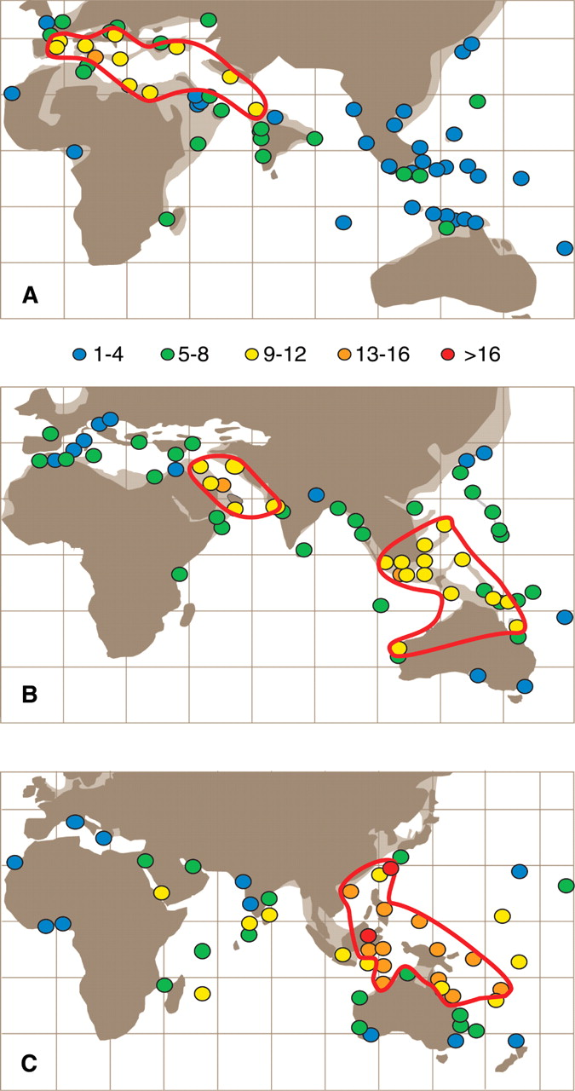
Renema, W., Bellwood, D. R., Braga, J. C., Bromfield, K., Hall, R., Johnson, K. G., ... & Pandolfi, J. M. (2008). Hopping hotspots: global shifts in marine biodiversity. science, 321(5889), 654-657.
Fig. 1. Generic α-diversity of large benthic foraminifera in
(A) the late Middle Eocene (42 to 39 Ma),
(B) the Early Miocene (23 to 16 Ma),
(C) the Recent.
Solid lines delimit the West Tethys, Arabian, and IAA biodiversity hotspots (tables S1 to S3). Note the relocation of hotspots across the globe. Where multiple studies occurred at a single locality, the highest recorded diversity is reported. Paleogeographic reconstructions modified after (41, 42).
41: J. Dercourtet al., Eds., Atlas Peri-Tethys. Palaeogeographical Maps (Commission for the Geological Map of the World, Paris, 2000).
42: R. Hall, J. Asian Earth Sci.20, 353 (2002).

Slide 17
Ocean Circulation and Reef formation

Slide 18
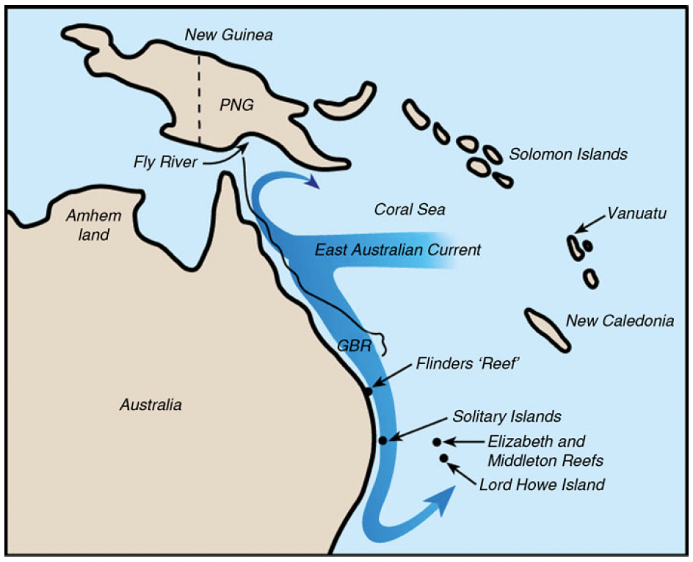
Ocean Circulation and Reef formation
Temperature control applies equally to corals and reefs on global/regional scales
Temperature is more limiting for reefs than corals
Corals can tolerate 15℃
Reef building cannot accrete under 18℃
With stronger poleward current, corals reach higher latitude
Notes:
Clear correlation between the distribution of corals is found only in the global scale, because reef formation does not depend on a high coral diversity.
Environmental control: requirement of shallow substrata, minimal quantities of mud of terrestrial origin, high light levels, high salinity, a suitable temperature regime, and Oaragonite of 3.8 or higher
No reefs
30S
Reefs in highest
latitude

Slide 19
Episodical development
Surviving as geological structures during intervals of emergence and cold (such as were created by the glacial cycles of the Pleistocene) and growing during interglacial warm intervals.

Slide 20
Surface current and dispersal

Slide 21
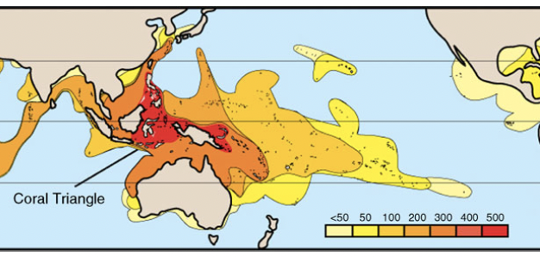
Surface current and dispersal
Coral larvae are able to make very long ocean journeys
(some weeks, even months)
Poleward Currents
Warm Currents regulate the composition of assemblages

Slide 22
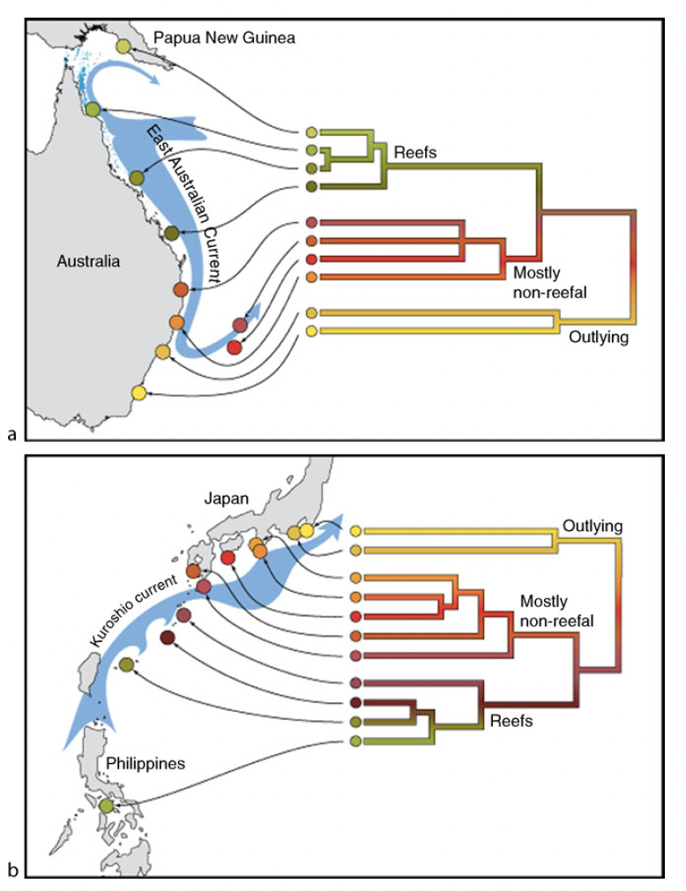
Surface current and dispersal
Coral larvae are able to make very long ocean journeys
(some weeks, even months)
Poleward Currents
Warm Currents regulate the composition of assemblages

Slide 23
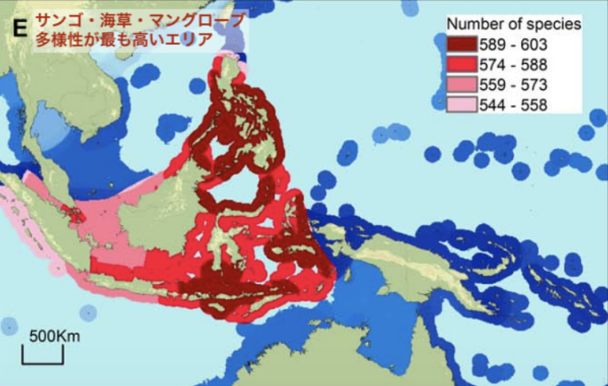
The Coral triangle
Sanciangco et al., 2013. PLoS ONE.
Possible reason for high diversity
‘Catch-all’ for larvae moving towards the region, which entrained in both the South Equatorial Current and the North Equatorial Current (Jokiel and Martinelli, 1992; Veron, 1995).
Attenuation with distance from the center of the Coral Triangle
Vicariance/reticulate evolution promoted by genetic mixing under complex eddies created by Indonesian Through-flow (Gordon and Fine, 1996)

Slide 24
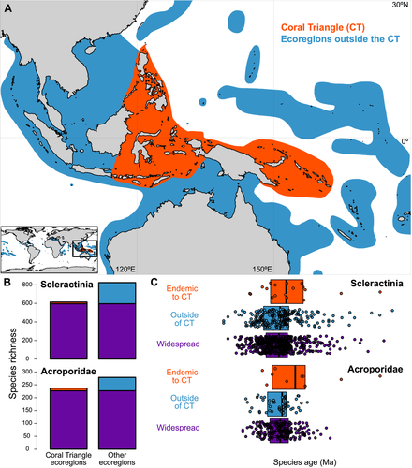
Huang, D., Goldberg, E. E., Chou, L. M., & Roy, K. (2018). The origin and evolution of coral species richness in a marine biodiversity hotspot. Evolution, 72(2), 288-302.
Origination rates within the CT are lower than in surrounding regions
Endemic species are
older than the others: endemicity is not due to recent speciation

Slide 25
Ocean Circulation and Evolution

Slide 26
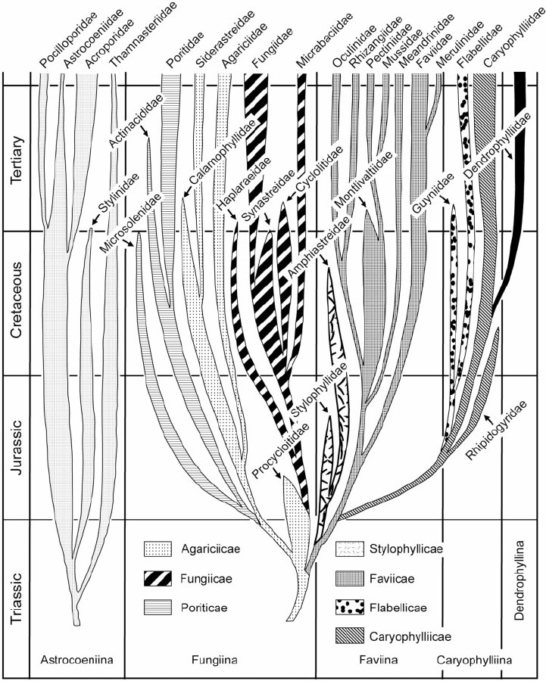
Difference in the time scale of dispersal and evolution
Corals disperse very fast
Shared species between the Great Barrier Reef, the Coral Triangle, and the Red Sea
Corals evolve very slow
Wells (1956, p. 363)
The link between those two processes has not been confirmed

Slide 27
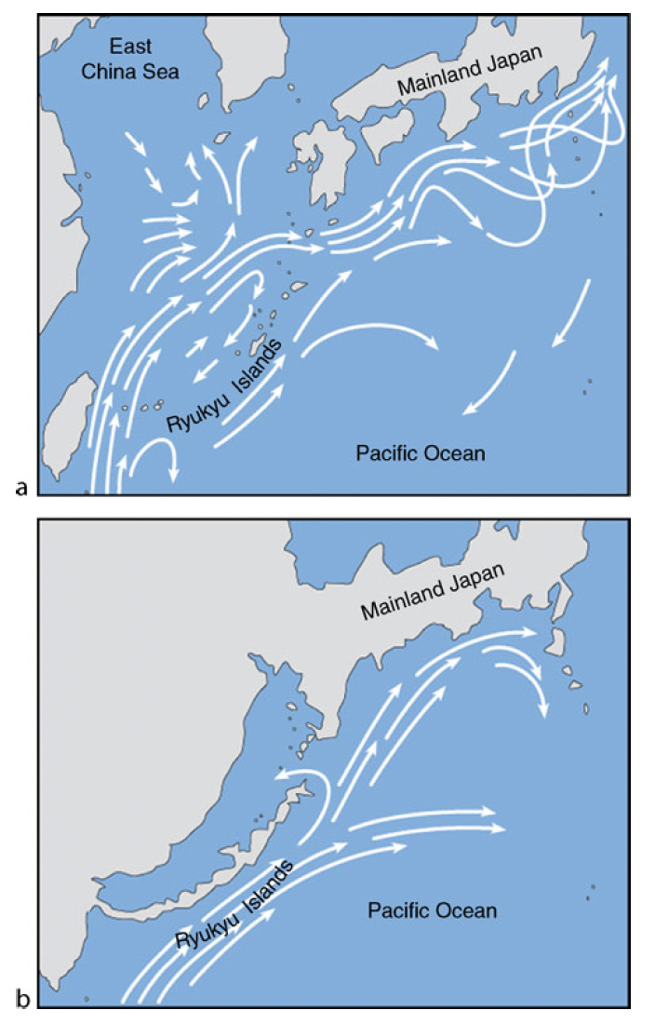
Change in Current resulted in genetic mixing
Tectonic uplift

Slide 28
Summary

Slide 29
Oceanic currents and coral reefs
Setting geographic extent of reef formation
Governing dispersal of larvae
Affecting evolution
Three dimensional nature of most types of shallow reef habitats
Fine-scale distribution of food, nutrients, oxygen, tides, waves
(out of scope of the article)

